Slide 1

Max, Rachel, Katrina

Slide 2
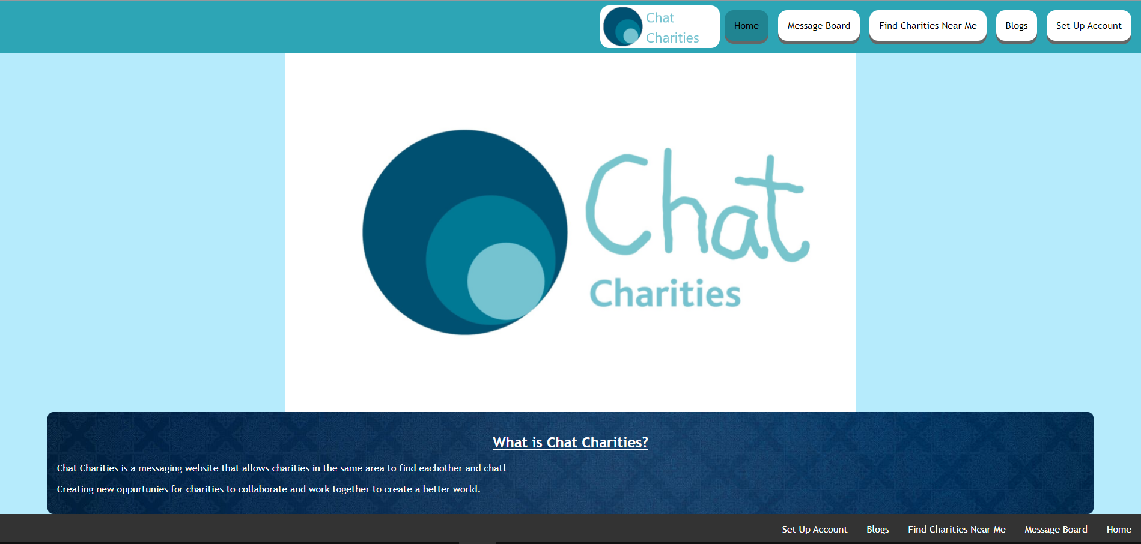
Main Page

Slide 3

Welcome to Chat Charities!
We have decided to create this website that will aid charities to communicate with each other. The way the page works is once you click the top page called "Find Charities Near Me", it will bring up a page with a list of the charities near you. Under each charity there will be a message box in which you can type your message and it will pass it onto them. This message will go into the email listed under the contact information.

Slide 4
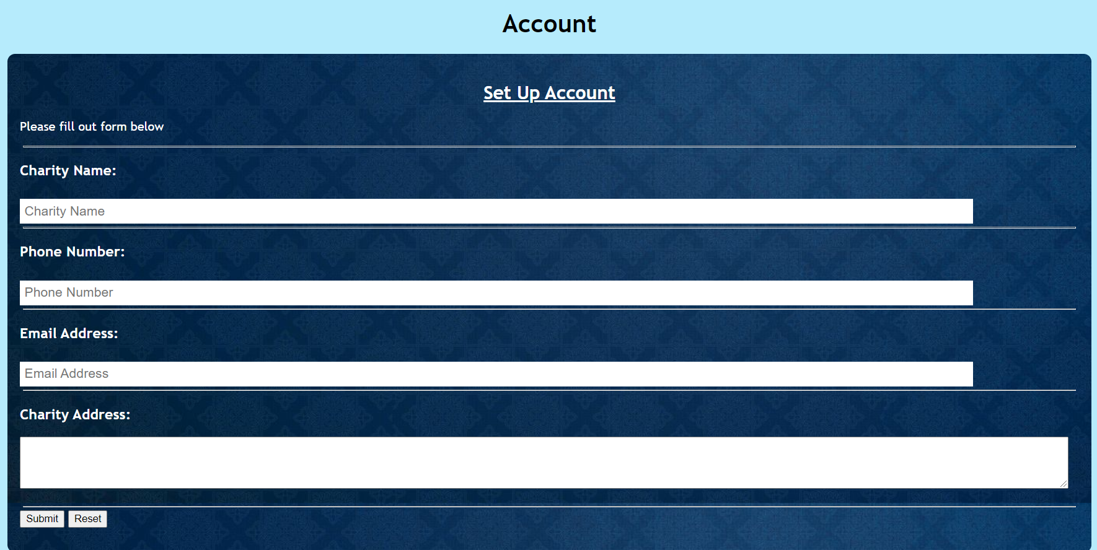

Slide 5
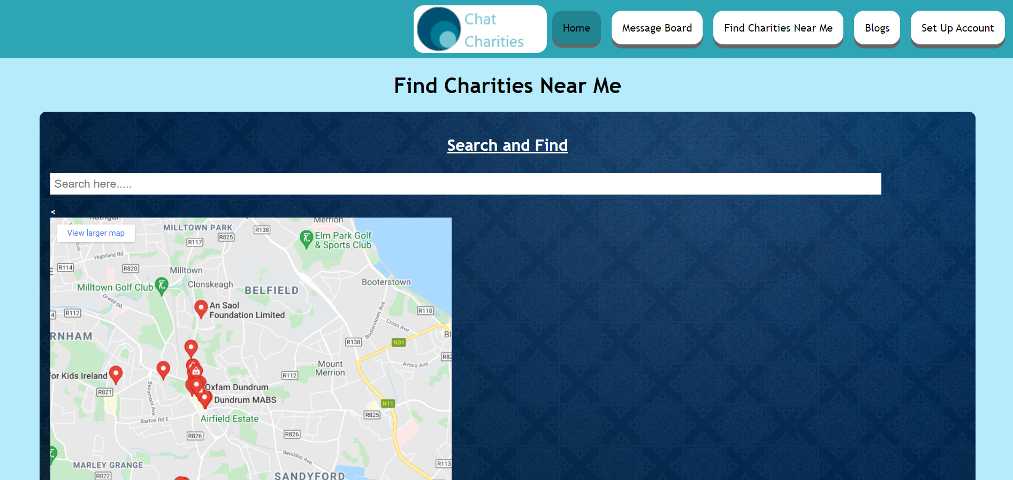
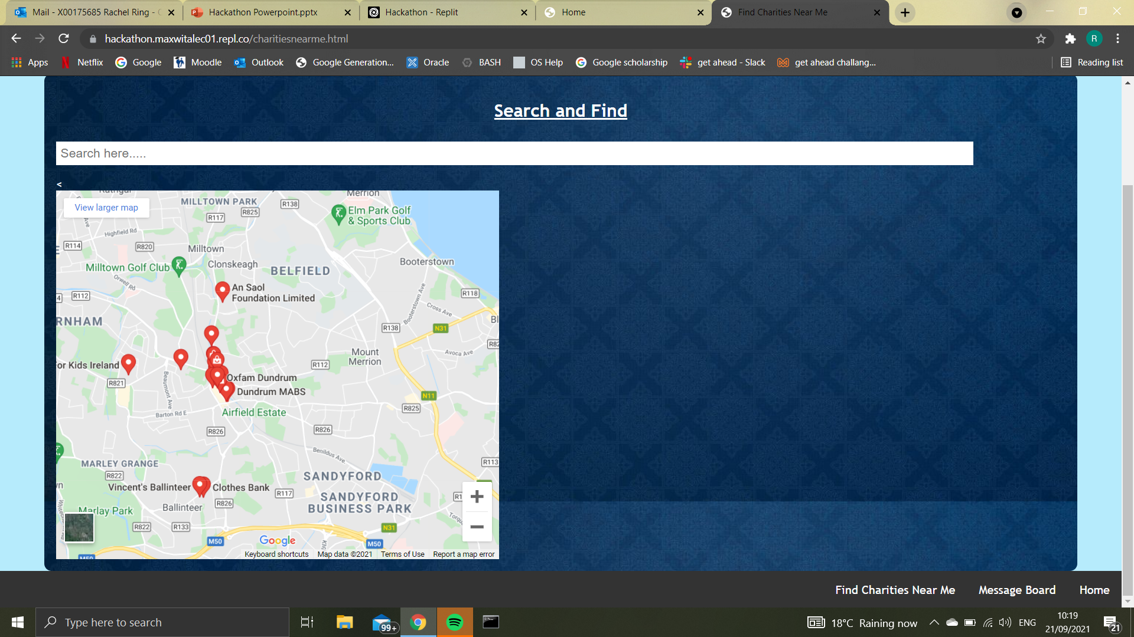
Find Charities Near Me
Charities can use this search facility to look for other charities near them. When setting up a profile for the site a charities location will be linked to their account and enable other users to find them.

Slide 6
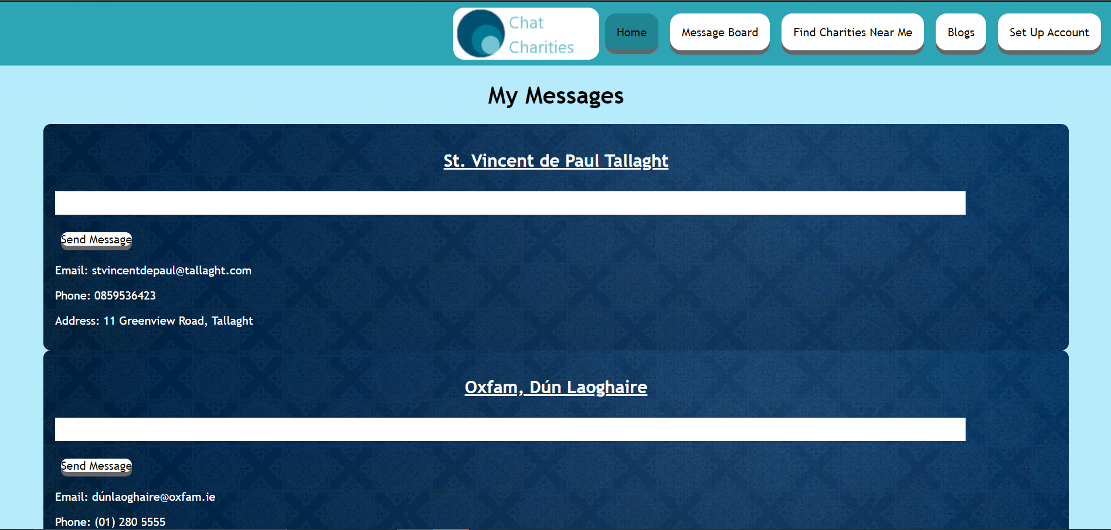
Messages
The message board is for clients to easily access the contact information of the charities most recently searched for by the account in use.
This page will also contain the information of the charities most searched for overall.
When the user account messages a new charity using this facility, the replies go straight to their email

Slide 7
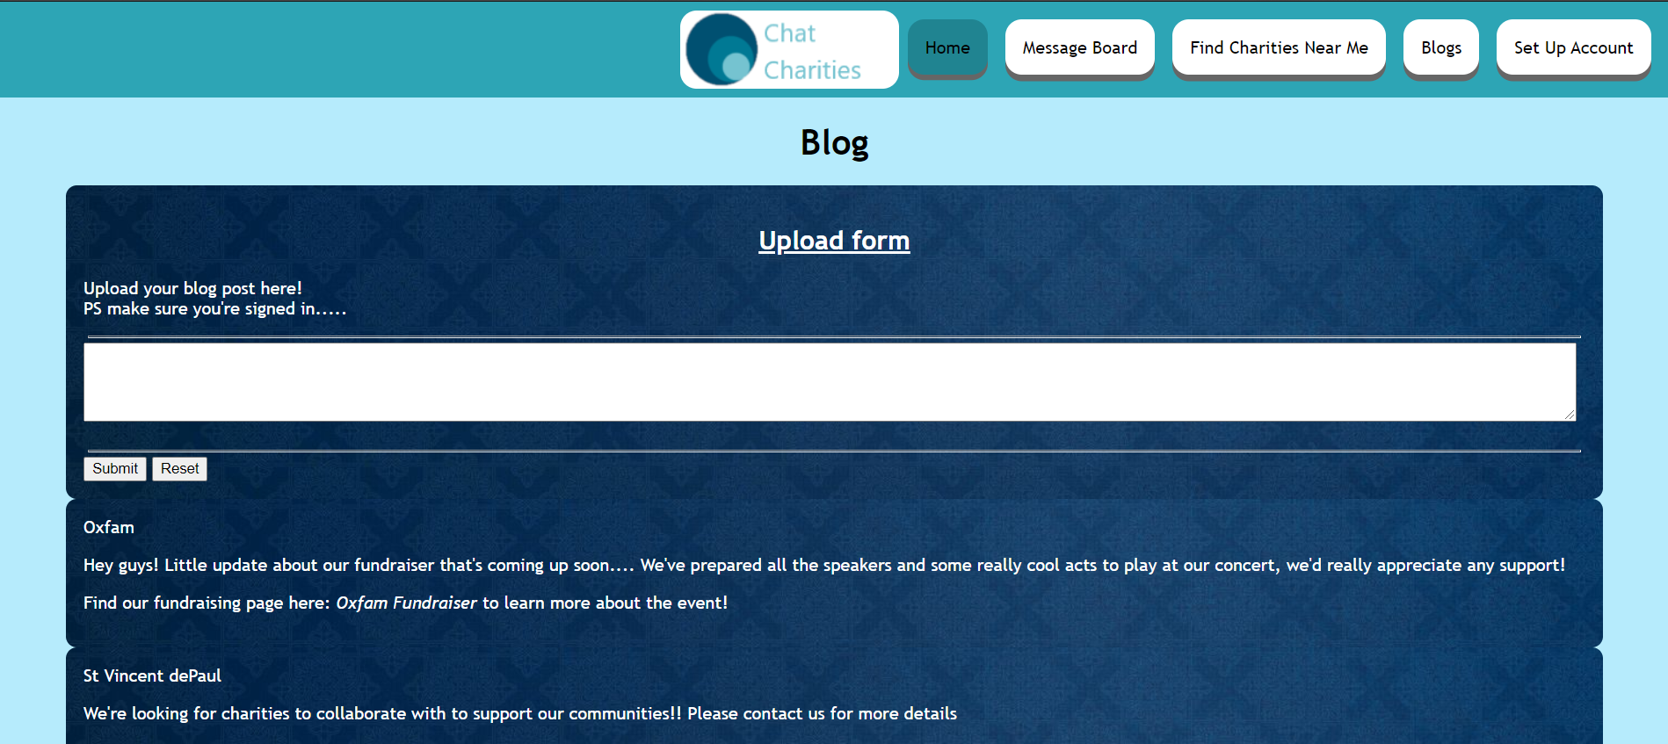
The blog page is for charities and organisatins to post updates and posts for everyone to see
This allows for the charities to connect with each other very easily!

